Slide 1
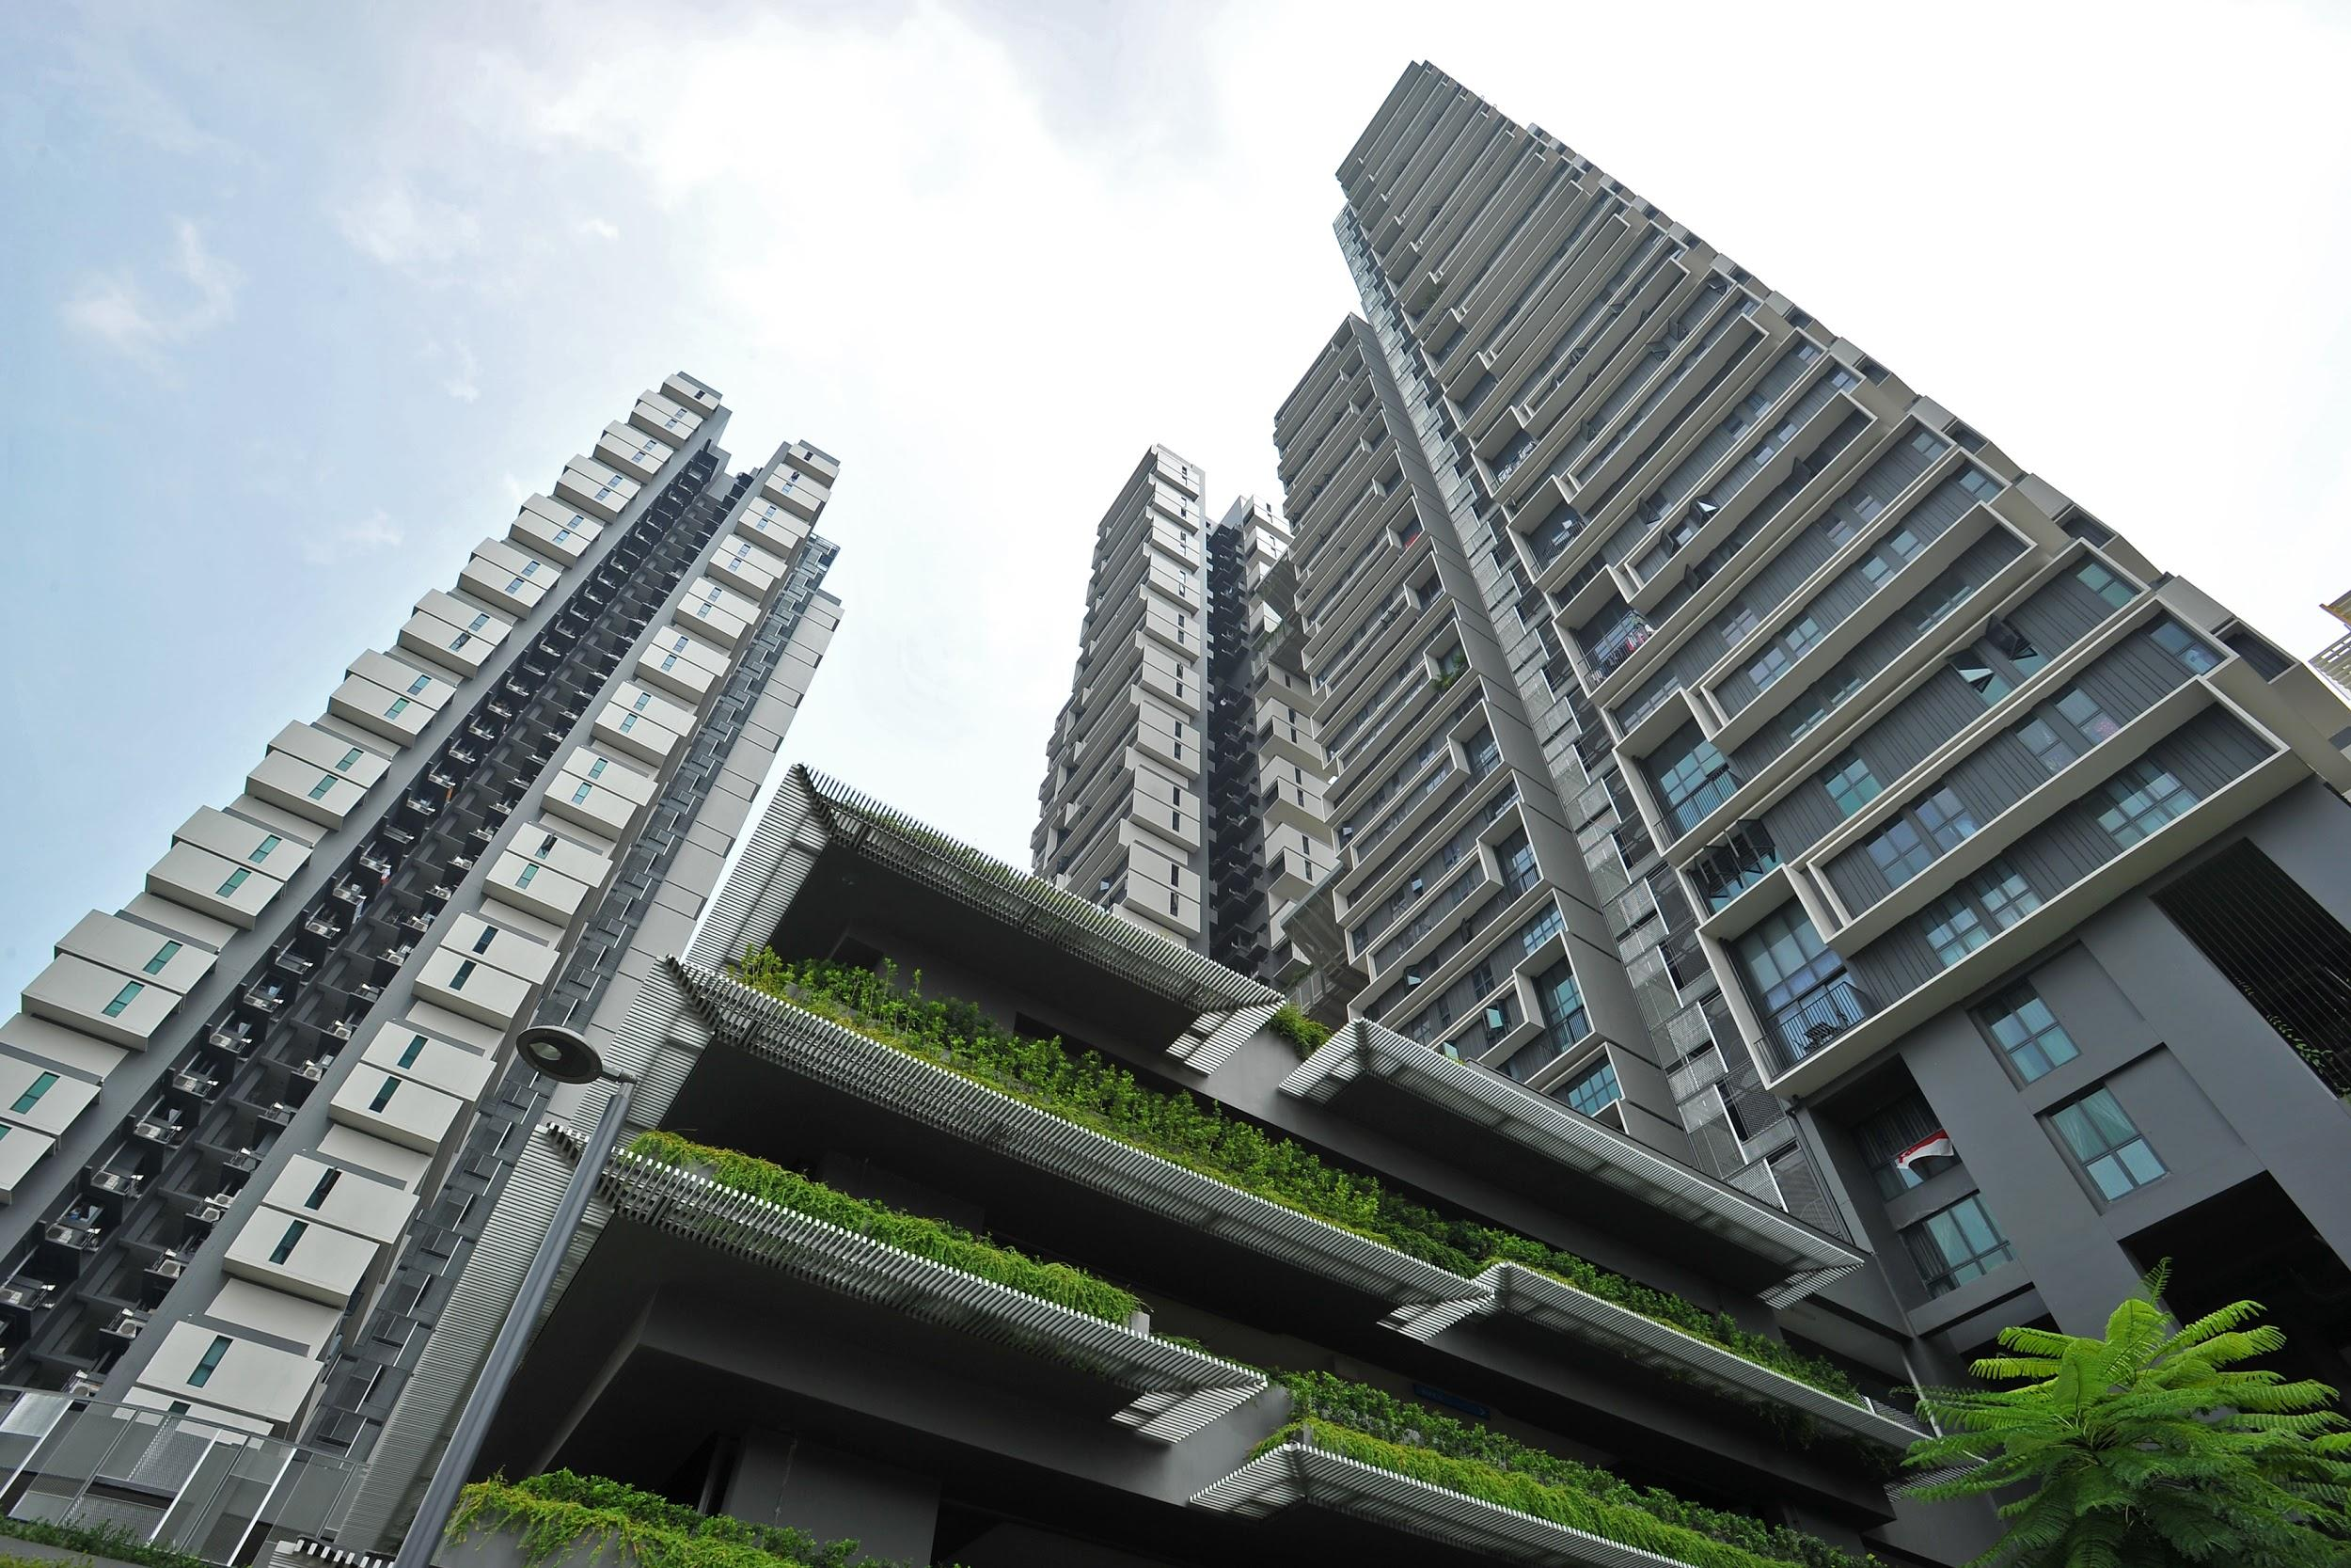
PA2 Presentation
Done by: Naufal, Ashraf, Javier, AJ, Zul, E Lynn
DFI/FT/3A/04

Slide 2

Group Headlines
Will Tengah Property Prices See The Same Rise As Punggol?
Will million dollar HDB flats be new new norm?
Here's what to expect for the upcoming "Average Price per Square Meter" for different Flat Types in the next 10 months

Slide 3
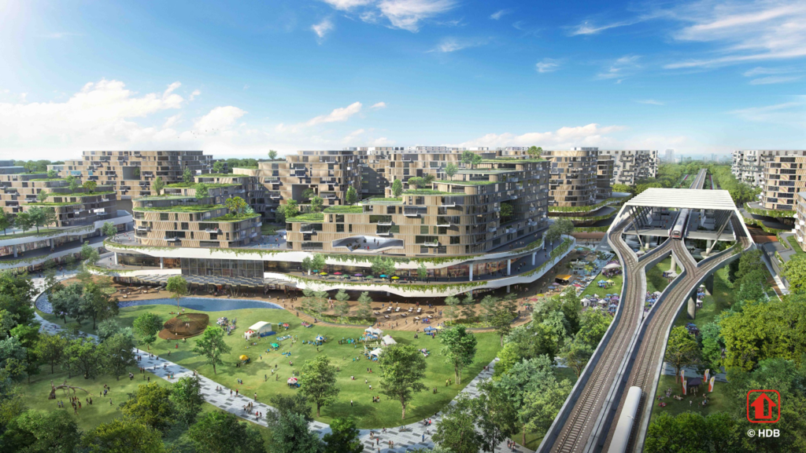
Headline #1
Will Tengah Property Prices See The Same Rise As Punggol?

Slide 4
Punggol was first unveiled in 1996 by former Prime Minister, Mr Goh Chok Tong
Vision: to make it the Waterfront Town in the 21st Century
An ambitious plan: to transform the old village of Punggol into a waterfront town with residential housing occupying along the rivers and coastal areas
A master plan to further realise the vision of Punggol as a waterfront town
Includes a man-made waterway that goes through the town, bringing in opportunities for authentic waterfront living and exciting water-based activities
10 years later, prices have skyrocketed to nearly $900,000, marking a new milestone in the HDB resale market for the suburban town in the region

Slide 5
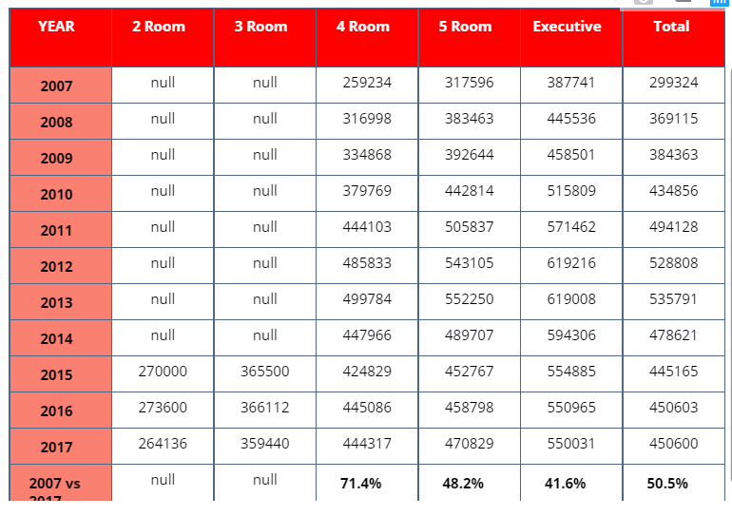
Due to Punggol’s early age, the resale value of 2 Room flats and 3 Room flats is not available until 2015.
2007 vs 2017

Slide 6
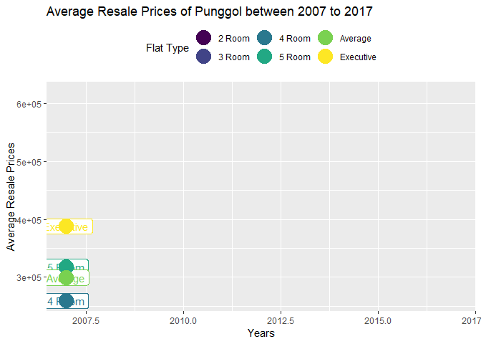
As the town continue to mature, new amenities and points of interest are built and formed.
ROH play a part from 2007 onwards as it was the year it started.

Slide 7
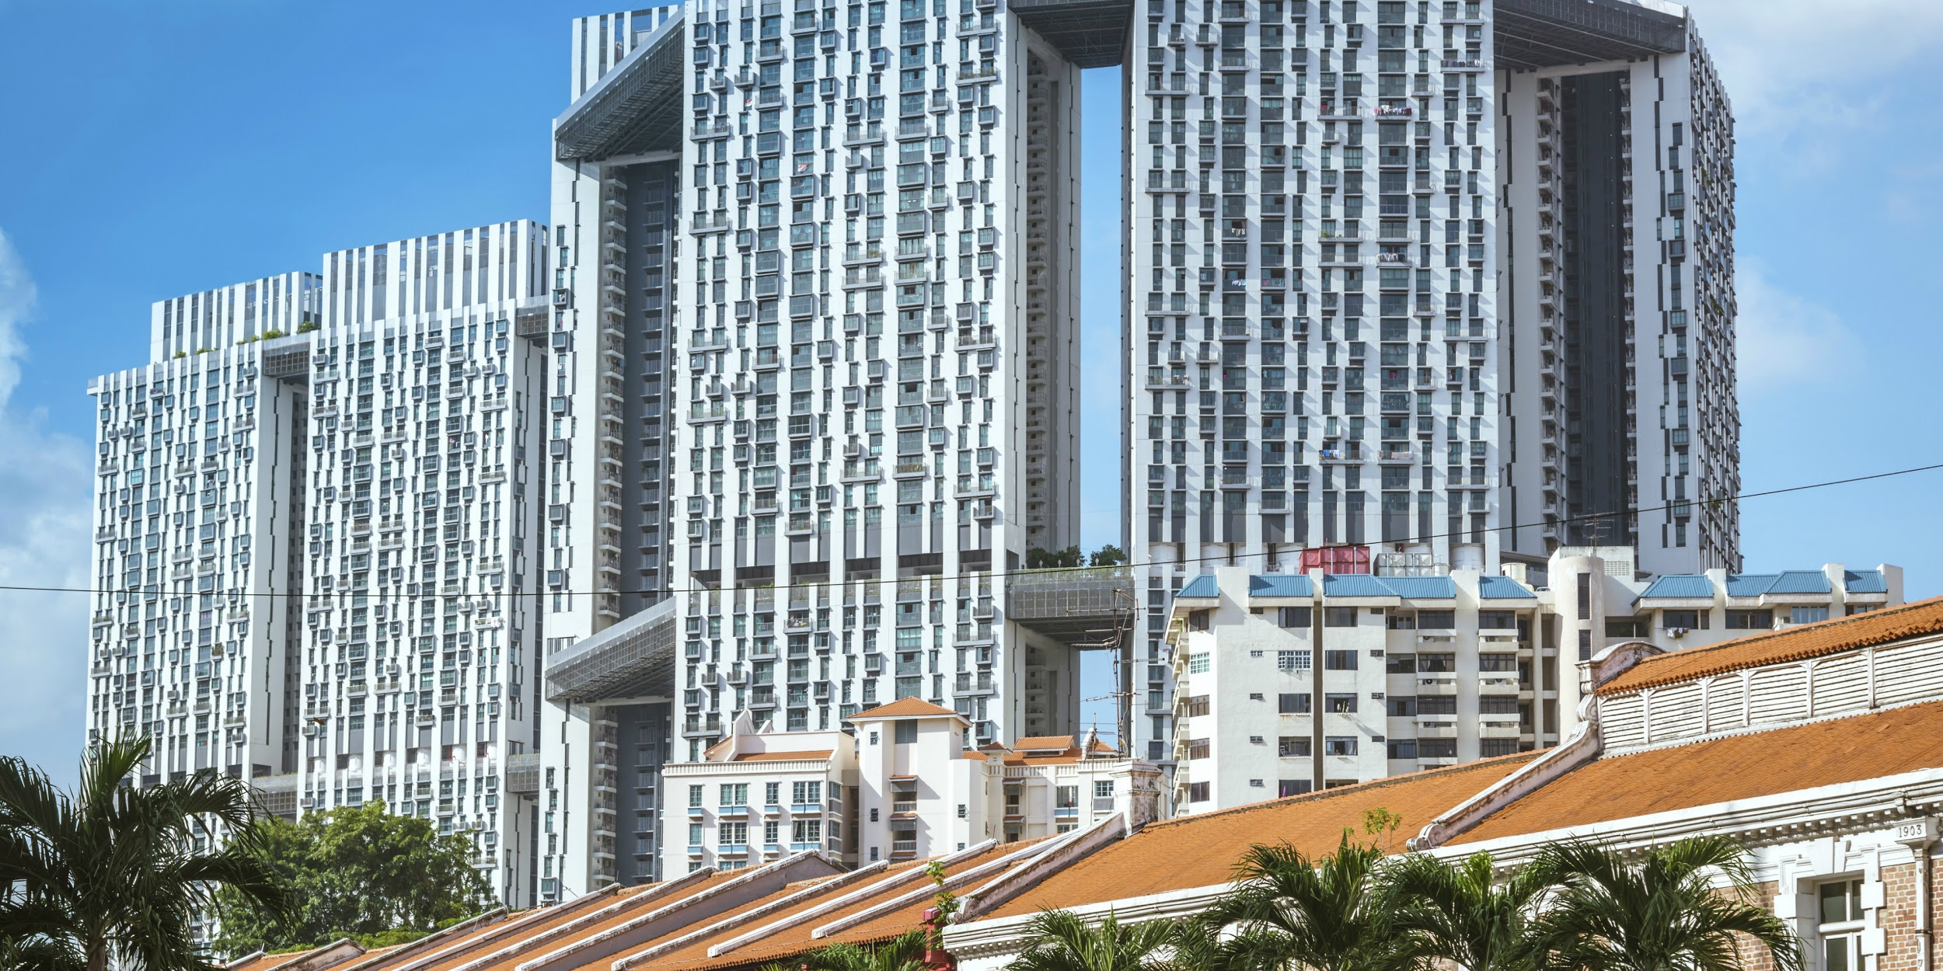
Headline #2
Will million dollar HDB flats be new new norm?

Slide 8
Will million dollar HDB flats be new new norm?
Over the years, HDB flats reaching close or at the $1 million mark
Will HDB mean affordable housing anymore?
Will Singaporeans expect to see million dollar HDB becoming the norm, potentially competing with the Private Property market?

Slide 9
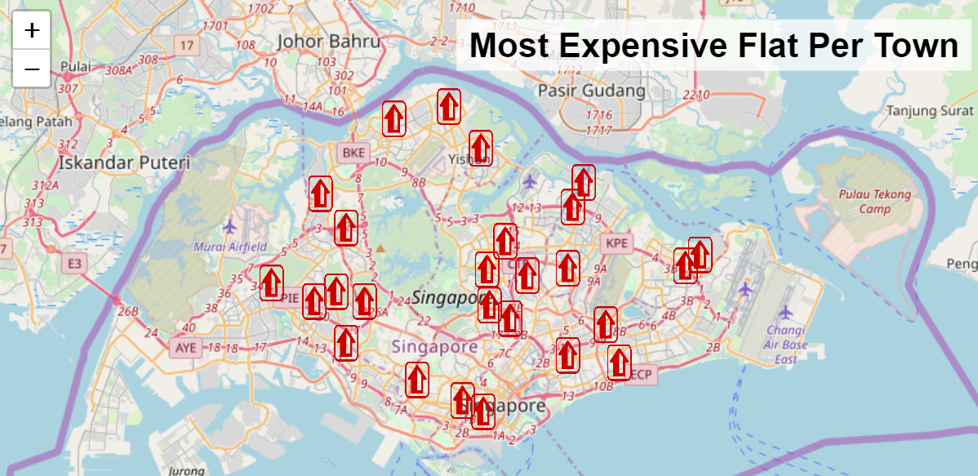
Most Expensive Flat per Town

Slide 10
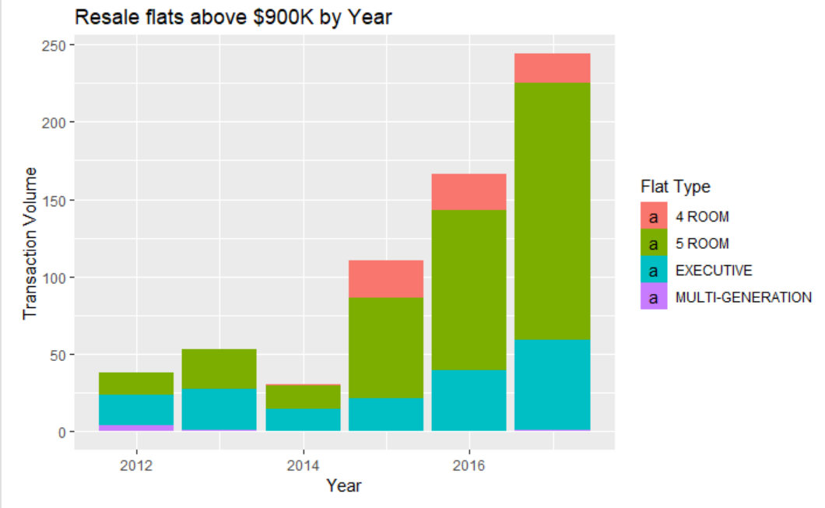
Resale Prices of Flats more than $900k
Use $900,000 rather than $1,000,000 as benchmark because:
Sellers would like to set their prices at least $1m but are often negotiated down
If it were set to $1m there wouldn’t be enough data points to form a effective insight
Therefore, setting it at $900,000 is a more realistic benchmark.

Slide 11
Resale Prices of Flats more than $900k
Sharp increase in transaction from 2015 onwards
4 Rooms are starting to set their prices above $900,000.
Furthermore,
most of the transaction were due to 5 Room flats which makes up about 70% in the year 2017 &
It is predicted that it will continue to increase in the foreseeable future

Slide 12
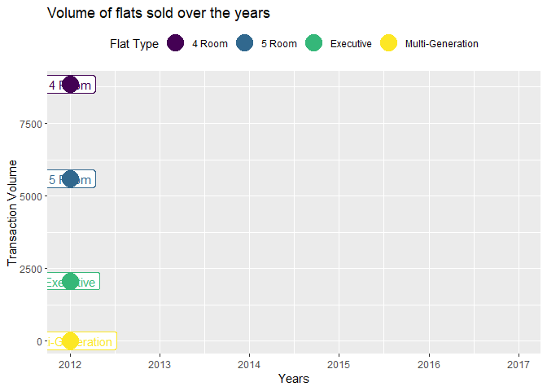
This graph shows the timeline of HDB flats that were sold per flat type
Between 2012 and 2013, there is a significant drop in transaction volume across all flat types.
Afterwards, we can see a gradual increase in transaction volume from 2014 onwards.
While 5 Room flats, Executive and Multi-Generation flat types are able to command higher prices, their individual volume is still lower that 4 Room HDB flats.

Slide 13
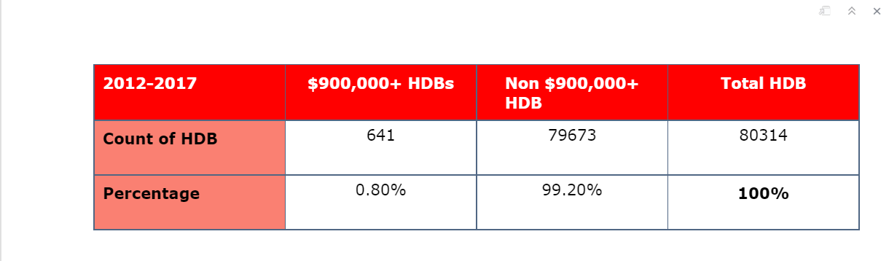
Table of HDB count
While the number of flats that are selling at high prices has indeed increased, this might not be as alarming.
The table below shows the percentage of flats sold that have exceeded the $9m from 2012 to 2017
Still below one percent which is 0.80% of all flats in that period
Therefore, $1m HDB flats are considered an exception and not the norm for the foreseeable future

Slide 14
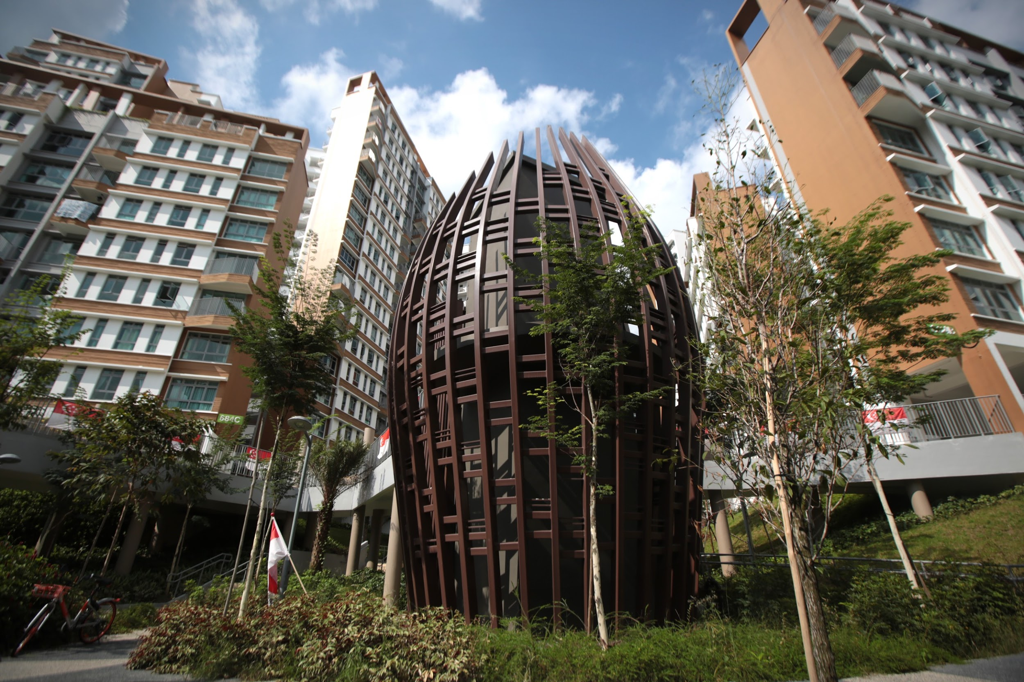
Headline #3
Here's what to expect for the upcoming resale prices (by flat types)

Slide 15
Predictive Model
As many houses are getting smaller, GlobNex has provided users to understand and expect ranges of the "Average Price per Square Meter" for each flat types to help families estimate the prices they are paying, allowing them to be able to recognise if the prices has been unreasonably priced
In this Prediction Model, GlobNex aim to predict future Price per Square Meter for different Flat Types in the next 10 months
With Shiny package, we have collated plot graphs to allow Users to visualize the Average Price per Square Meter

Slide 16
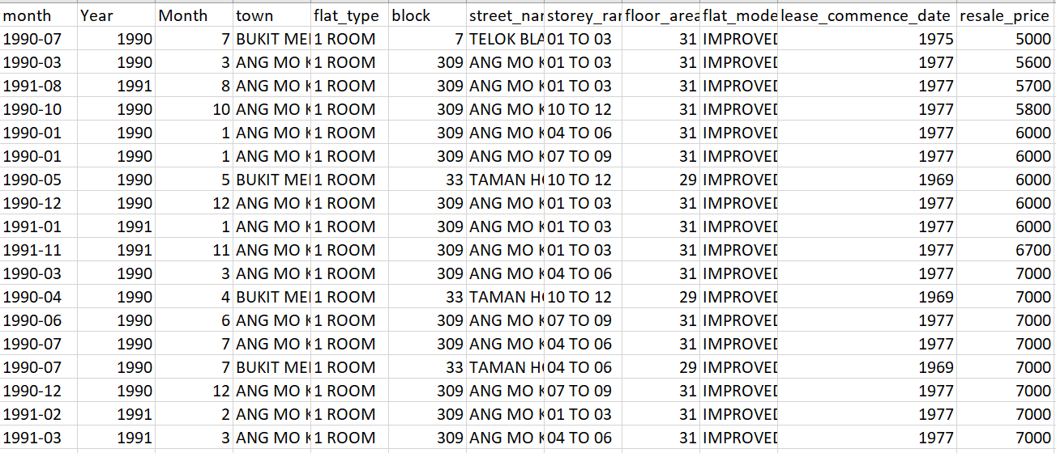
Data Source:
HDB Resale Prices

Slide 17
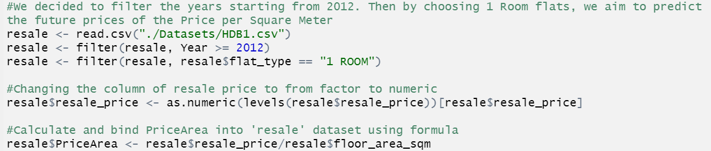
Filtering of data

Slide 18
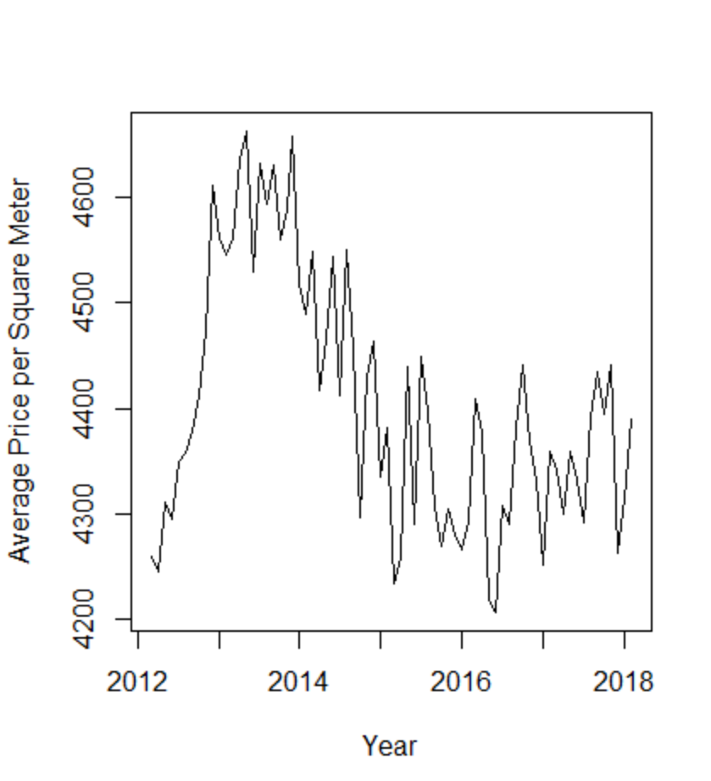
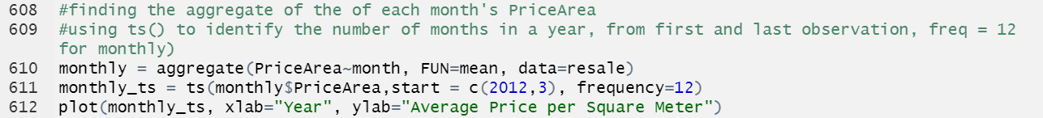
Aggregate by months

Slide 19
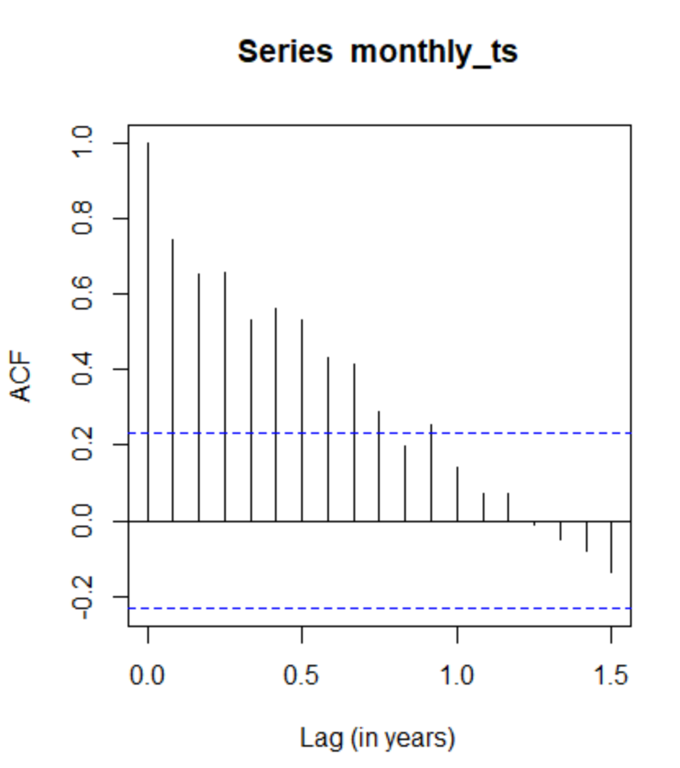
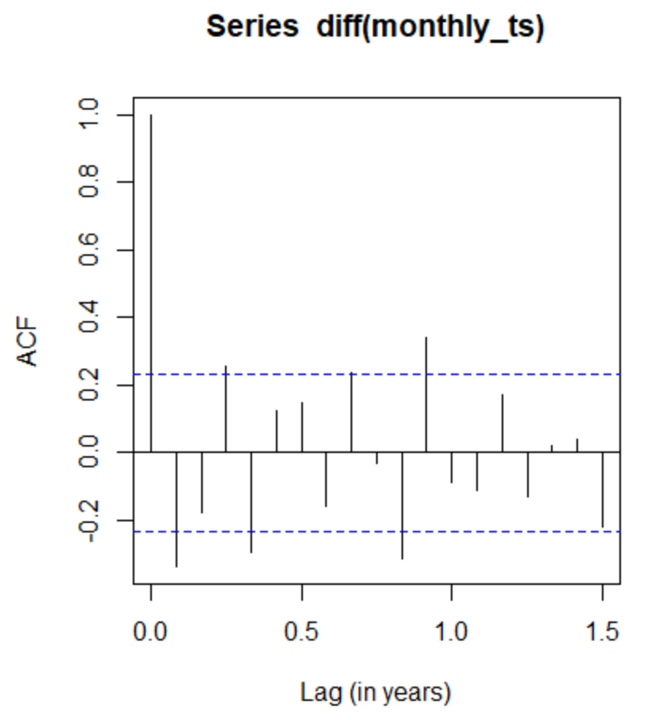
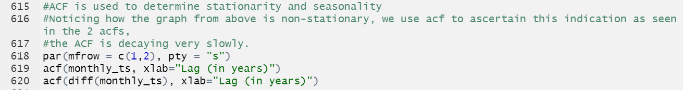
Determining with ACF

Slide 20
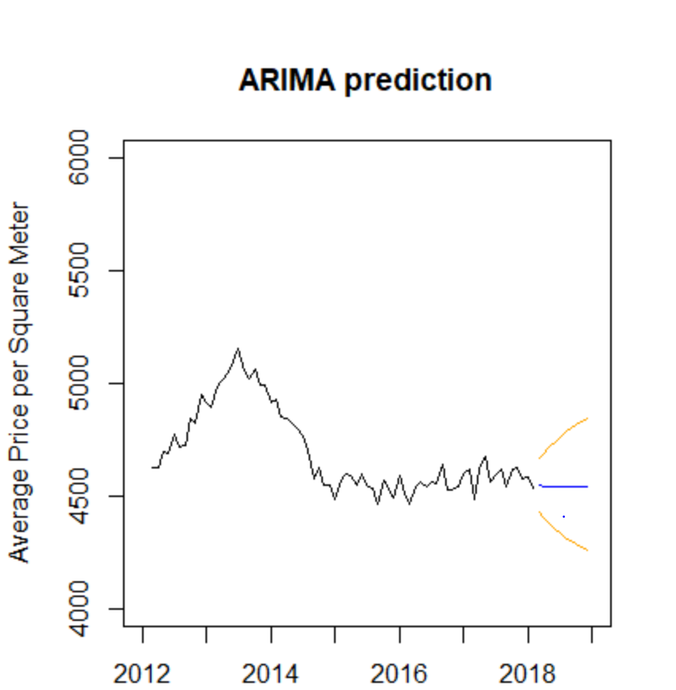
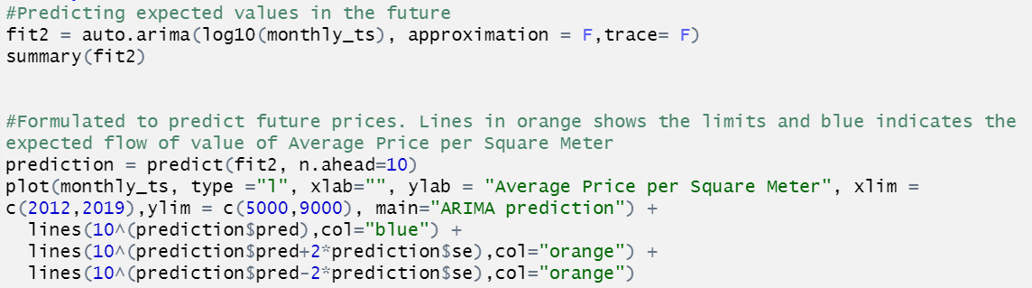
ARIMA Predictions for next 10 months

Slide 21
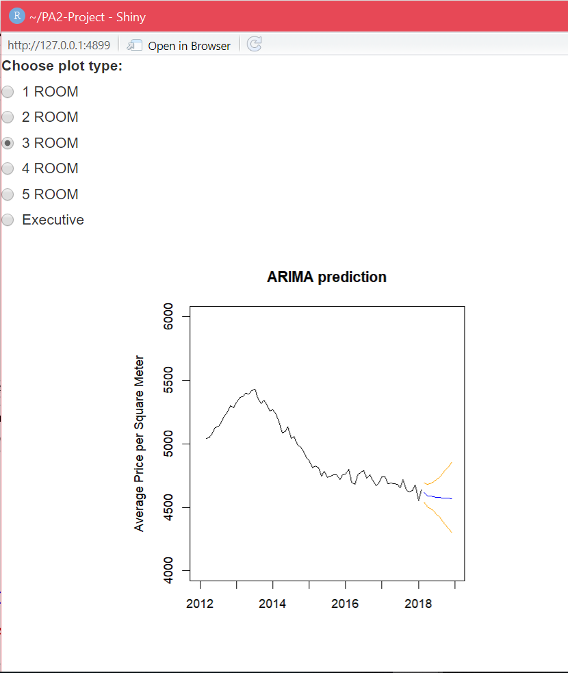
ARIMA Prediction

Slide 22
Individual Visualization
Remaking our Heartland
Relationship between POI and Resale Price
Why prices drastically increase 2007 onwards
Value comparison between Mature towns and Non-Mature Towns
Comparing Flat types from 1990s to 2000s
Compare Median Resale Price against Dataset

Slide 23
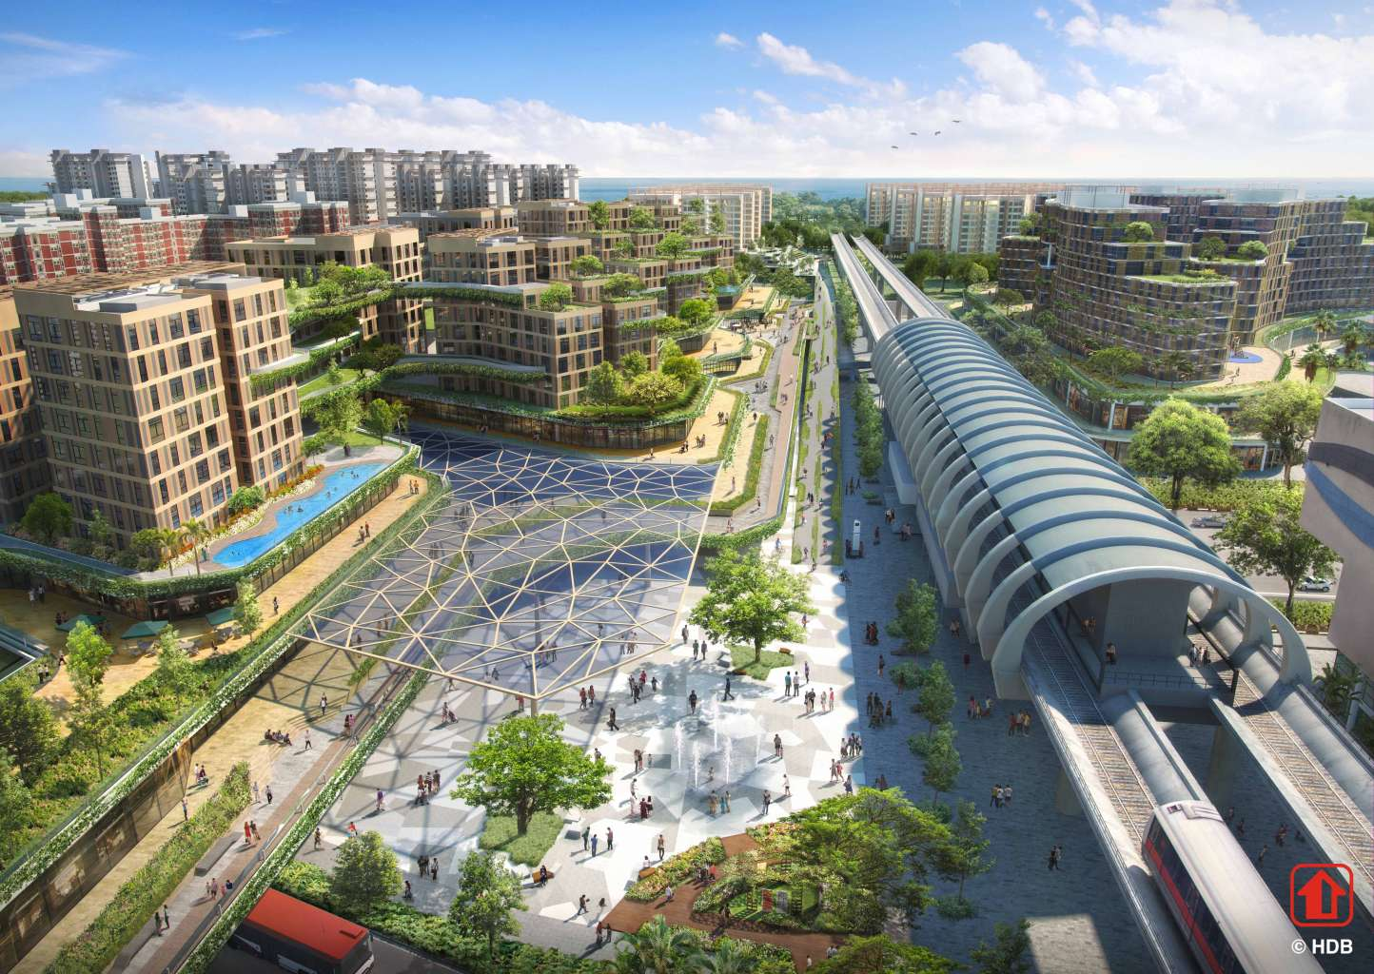
Visualisation 1
Remaking our Heartland

Slide 24
Remaking our Heartland
"Remaking our Heartland" is a program by HDB to renew and further develop existing HDB towns and estates,
and to ensure sustainability and vibrancy of the HDB heartlands.
This generally includes building more amenities within the neighbourhood to give residents a higher standard of living.

Slide 25
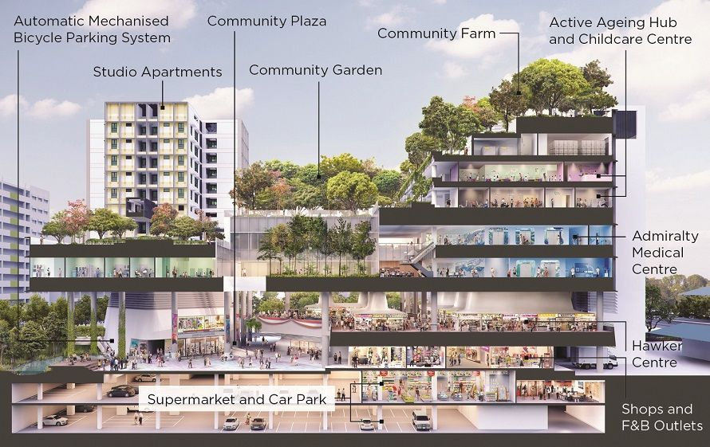

Slide 26
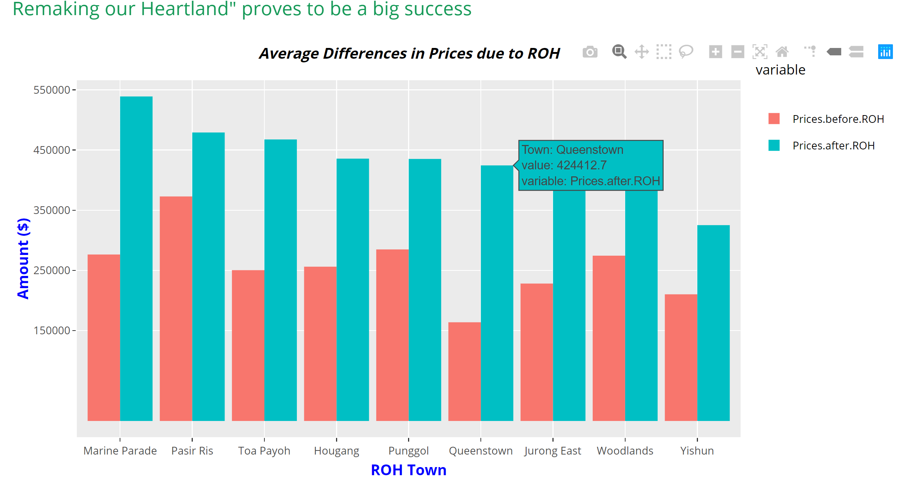

Slide 27
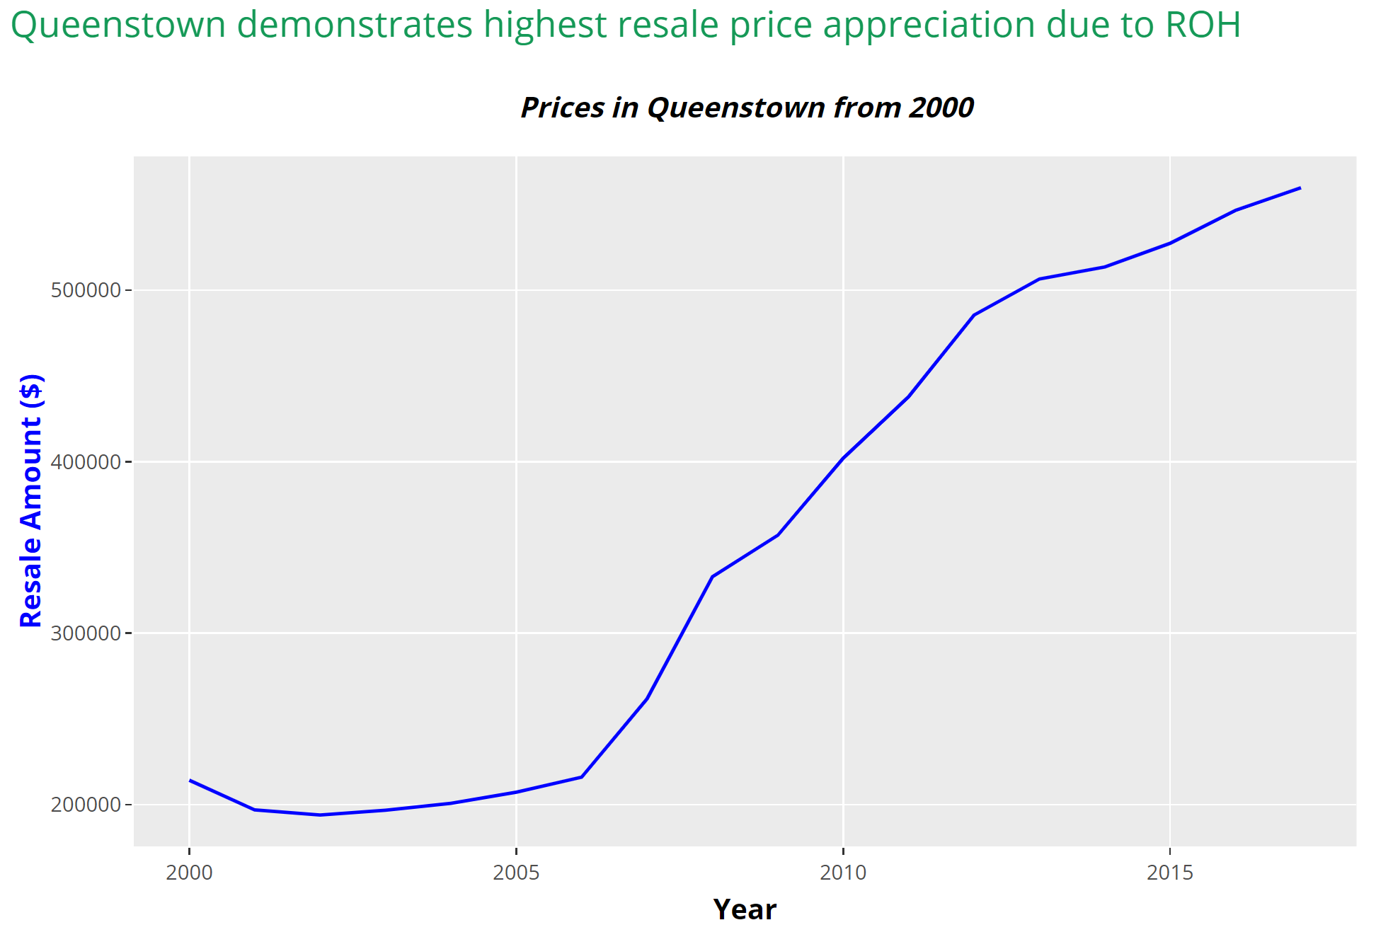

Slide 28
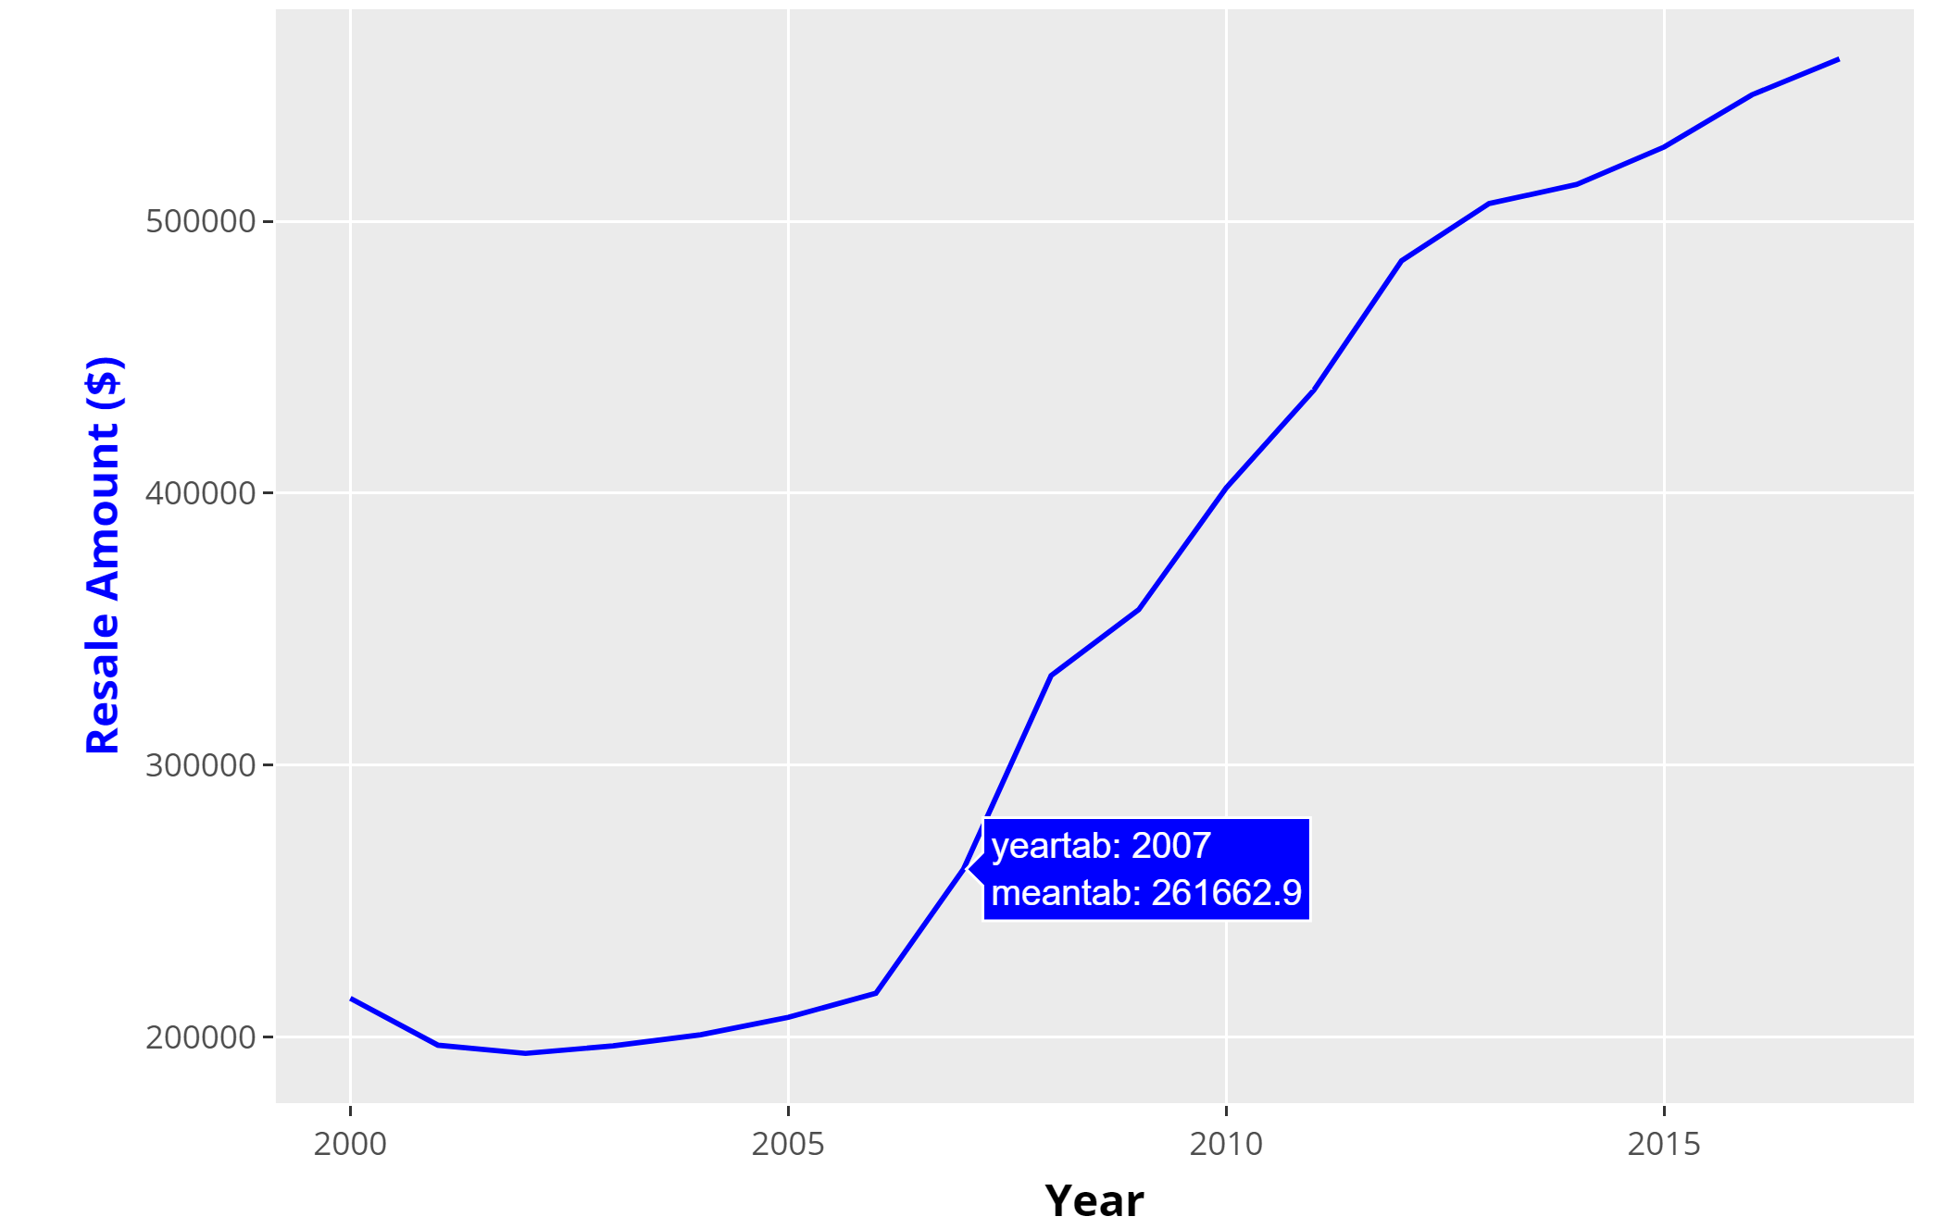

Slide 29
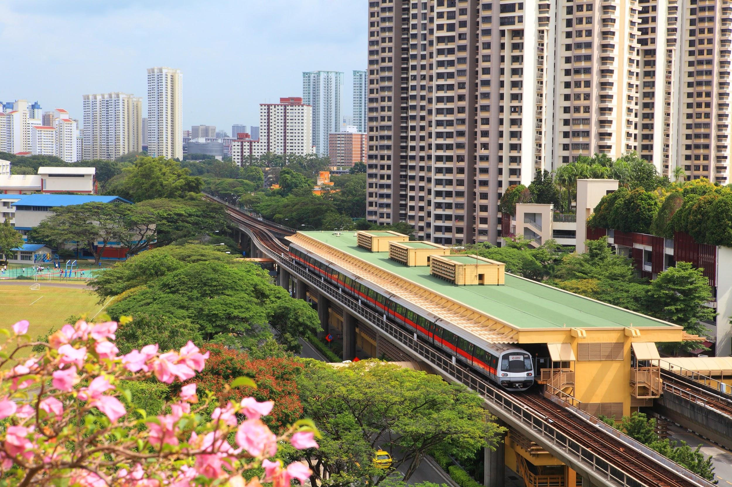
Visualisation 2
Relationship between POI and Resale Value

Slide 30
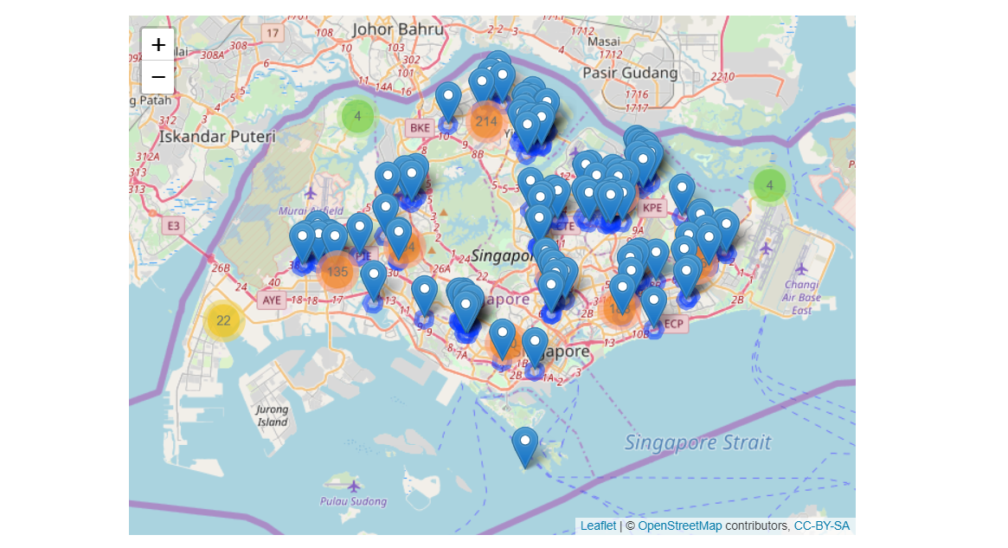
Dataset:
Attractions
Community Clubs
Hawker Centres
Higher Education Institutions
Hospitals
Polyclinics
MRT and LRT Stations
Parks
Kindergartens
Primary Schools
Secondary Schools
Shopping Malls
Supermarkets
We then use a sample of 100 HDB flats with their lat and long and apply it into the map.

Slide 31
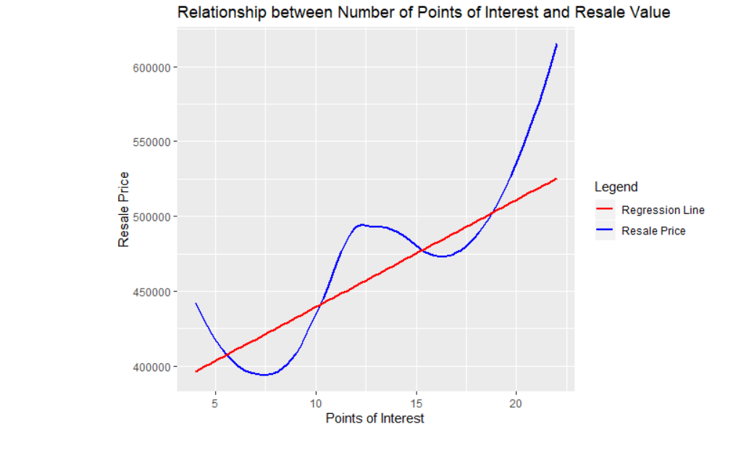
POI & Resale Price
The more the POI, the higher the Resale Price
Amenities, transports links building services contribute to POI and therefore increasing Resale Price.

Slide 32
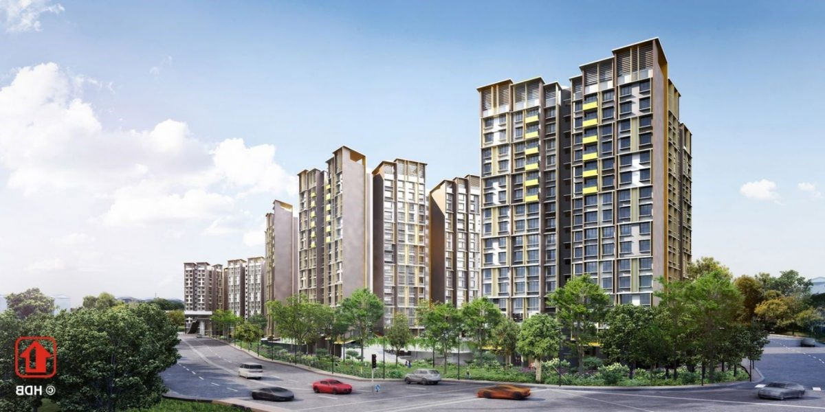
Visualisation 3
Singaporeans' HDB predicament: HDB dilemma for the future

Slide 33
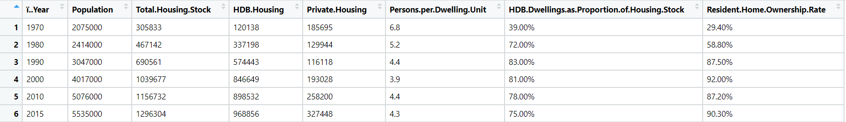
Headline: Singaporeans’ HDB predicament: HDB dilemma for the future
Data Source:
https://www.econstor.eu/bitstream/10419/161439/1/852480318.pdf
Econstor.eu

Slide 34
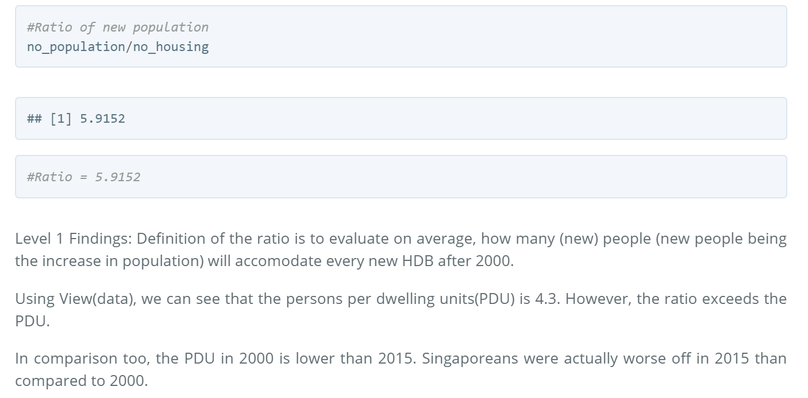
Headline: Singaporeans’ HDB predicament: HDB dilemma for the future

Slide 35
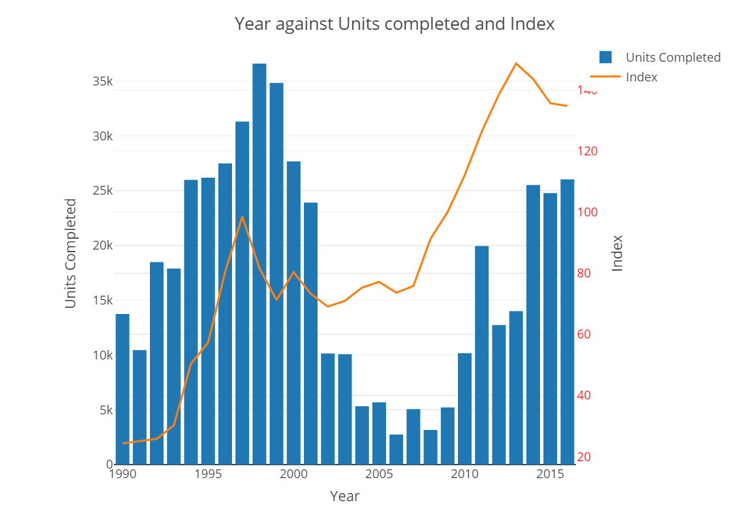
Headline: Singaporeans’ HDB predicament: HDB dilemma for the future
Level 2 Findings:
Findings have shown that prices have skyrocketed from 2008 onwards.
On the other hand, the units completed over the years against the population growth faces a mismatch, as there are more Singaporeans than available HDBs.
This supply and demand forced the prices to increase drastically.

Slide 36
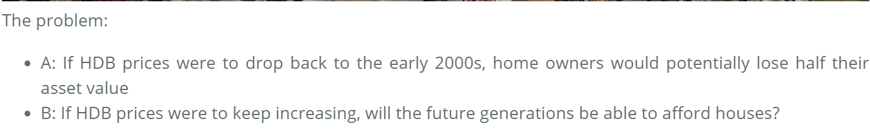
Headline: Singaporeans’ HDB predicament: HDB dilemma for the future

Slide 37
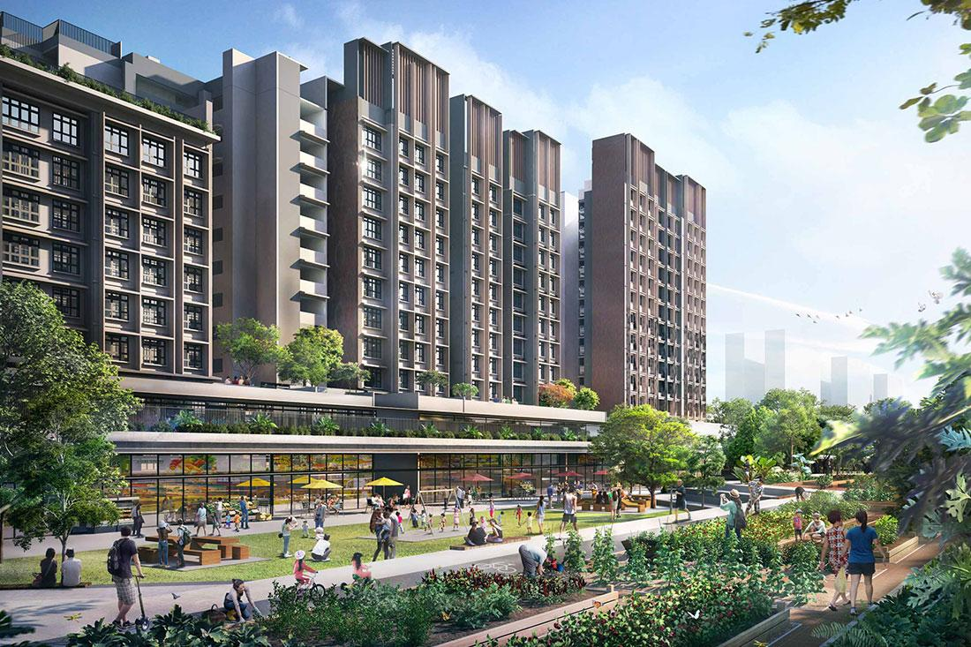
Visualisation 4
Comparing Mature & Non-Mature Estates

Slide 38
Comparing Mature & Non-Mature Estates
Maturity of an estate or town refers to its age
Towns that have been around for more than 20 years are deemed mature
Those that have been built more recently are considered non-mature
The main difference: in general, the mature-estates have mature neighbourhoods and better amenities

Slide 39
Town Classification
Mature Towns | Non-Mature Towns
Ang Mo Kio Bedok Bishan Bukit Merah Bukit Timah Central Clementi Geylang Kallang Marine Parade Pasir Ris Queenstown Serangoon Tampines Toa Payoh | Bukit Batok Bukit Panjang Choa Chu Kang Hougang Jurong East Jurong West Punggol Sembawang Sengkang Woodlands Yishun

Slide 40
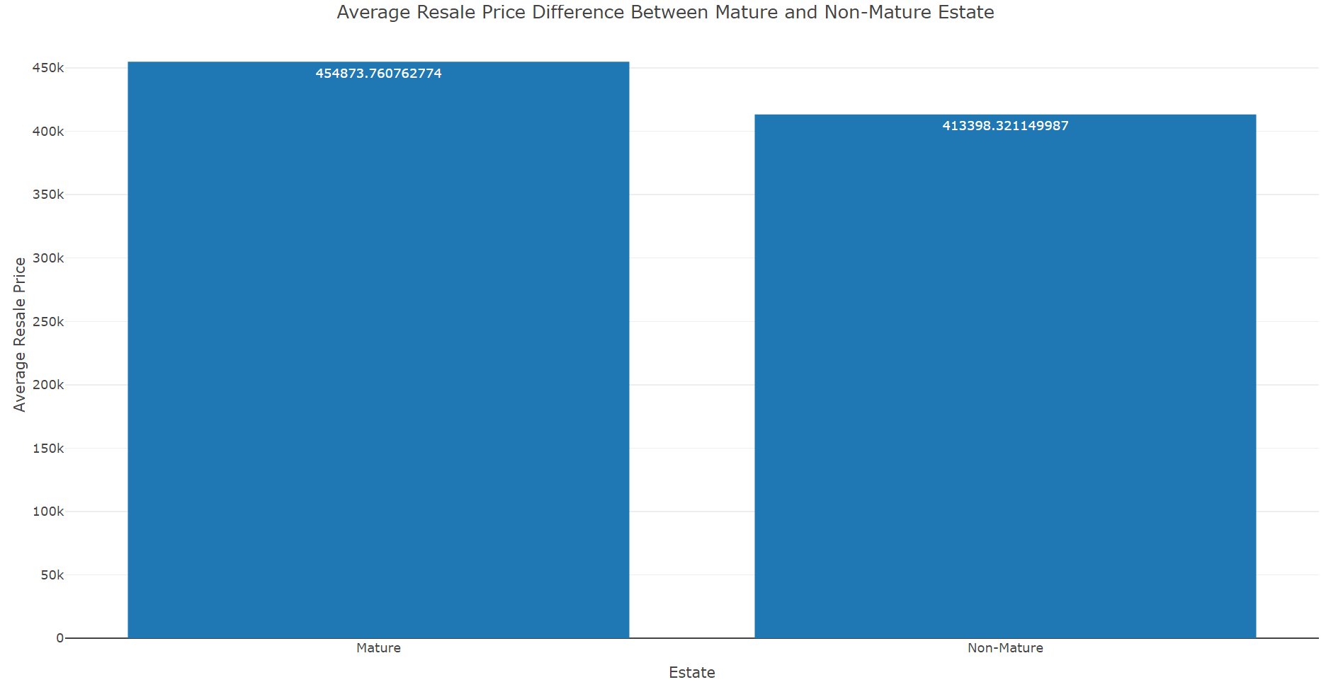

Slide 41
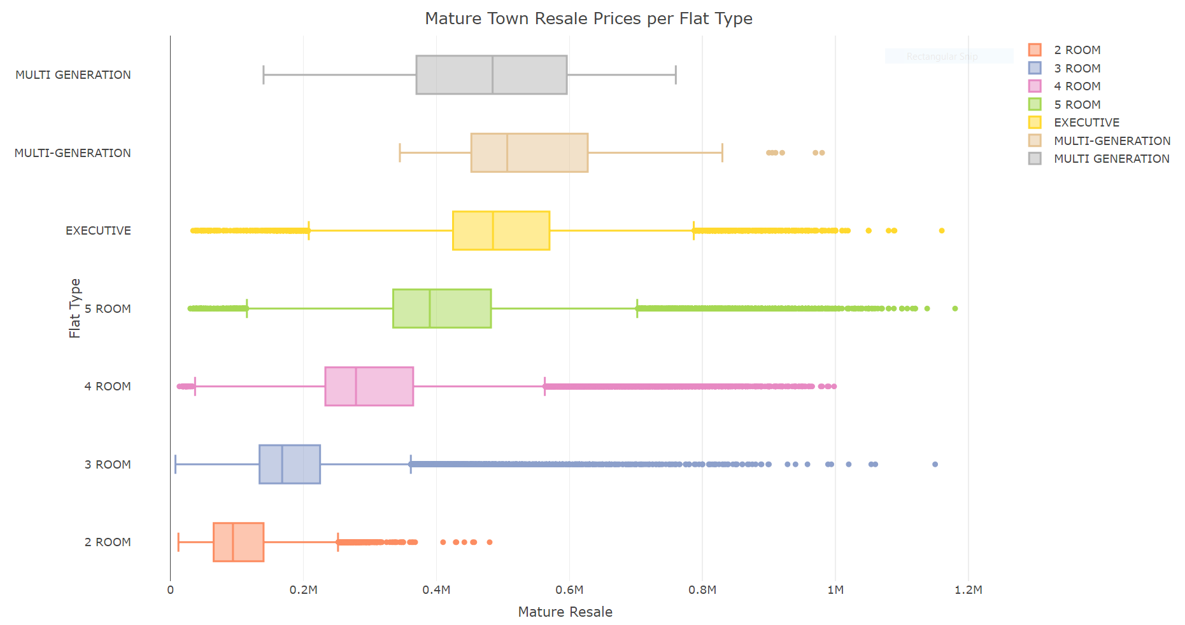

Slide 42
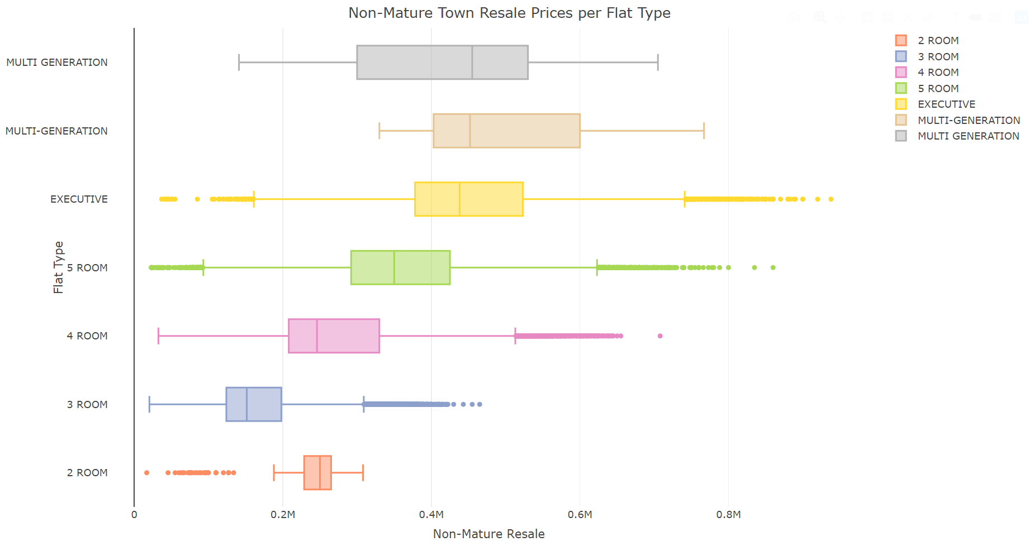

Slide 43
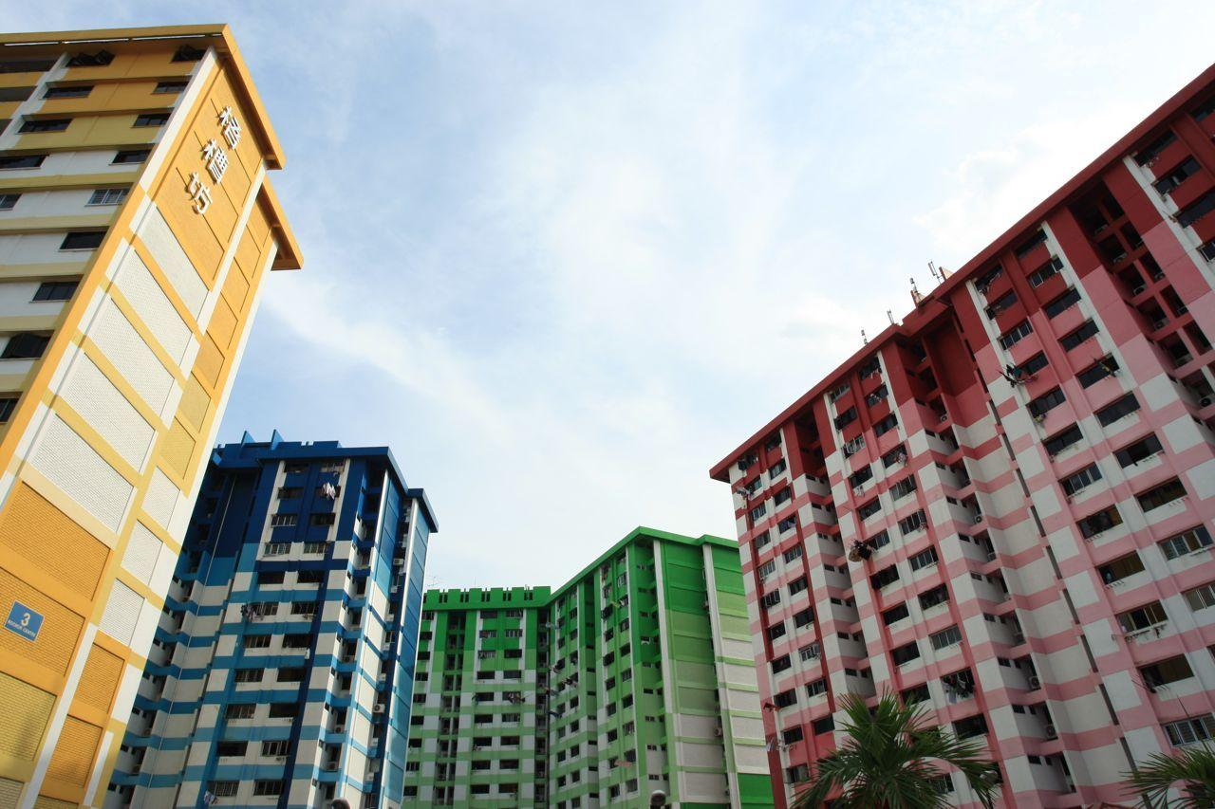
Visualisation 5
Comparing flat type sold from 1990s to 2000s

Slide 44
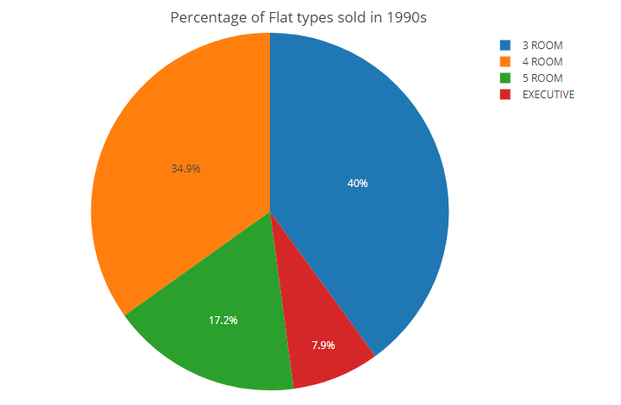
Flats types that are sold in the 1990s
Many of the upcoming families will need shelter for their own, thus, the flats sold have been on an increase state.
Both 3 Room & 4 room stands out as the majority with the combination of 74.9%
Total percentage of the flat types that have been sold which is equivalent to 211,787 flats sold in that era

Slide 45
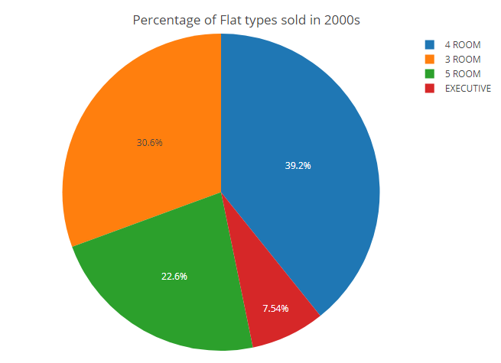
Flats types that are sold in the 2000s
Both percentage which the flats have been purchased is 69.2% which is a decrease of 5.7% compared to the 1990s
There is 5.4% increased on 5 room flats that have been sold in the 2000s
A decrease of 0.36% to those sold in 2000s as compare to the 1990s for Executive Flats

Slide 46
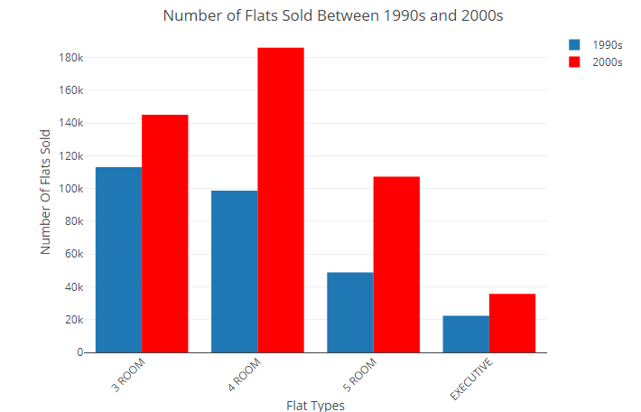
Comparison of both flat types on both periods
Significant increase for
4 room flats having difference of 87,339 flats sold during the 1990s and 2000s
5 room flats with a difference of 58.776 flats sold during the 1990s and 2000s
Resale price due to the increase sales of flat types over 10 years

Slide 47
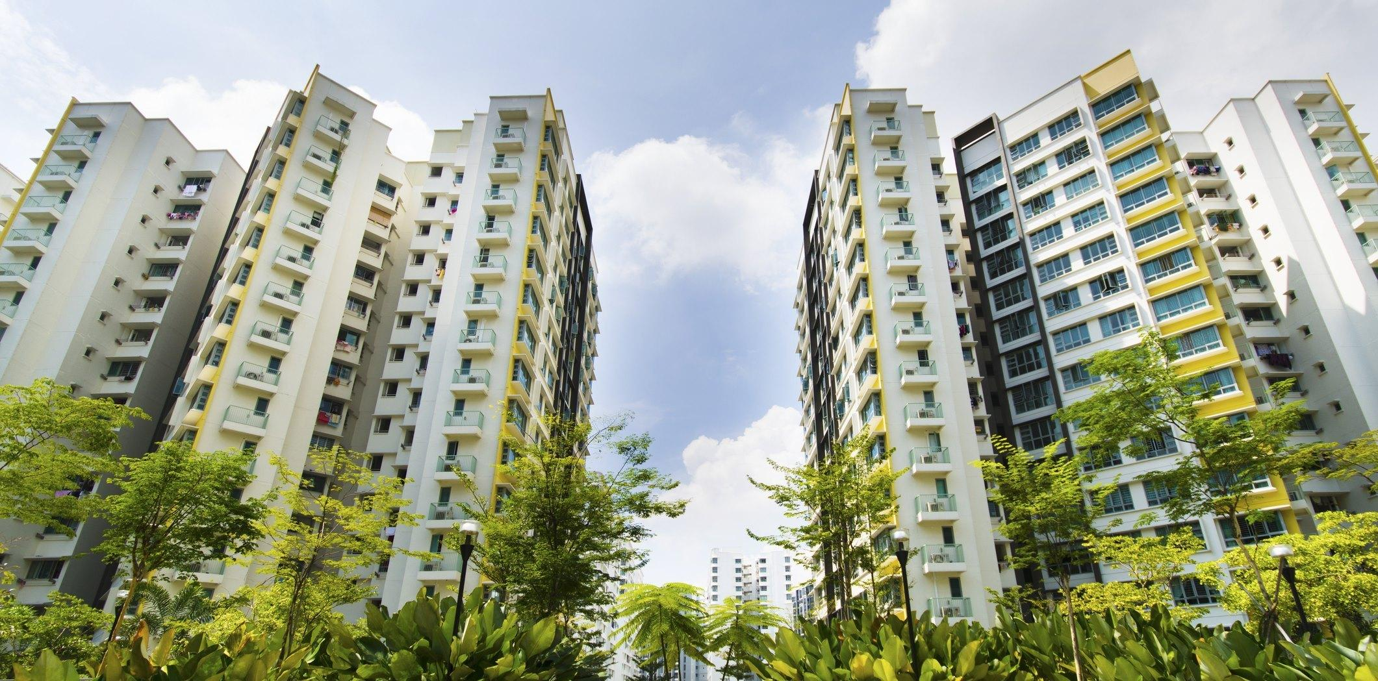
Visualisation 6
Comparing Median Resale prices against other towns

Slide 48
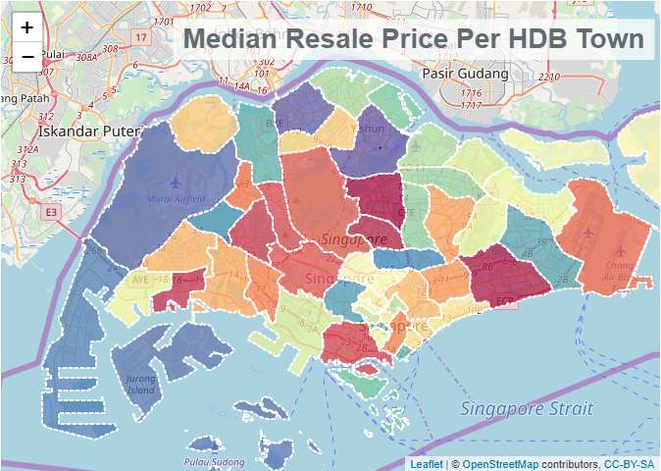
Map was taken from the URA website
Borders to distinguish towns
3 observations that are 5 years apart each to show trend over the years

Slide 49
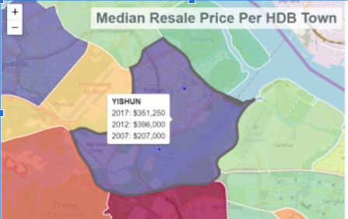
Able to zoom in to specific towns
Can see the Median resale price when you hover over the town

